Slide 1
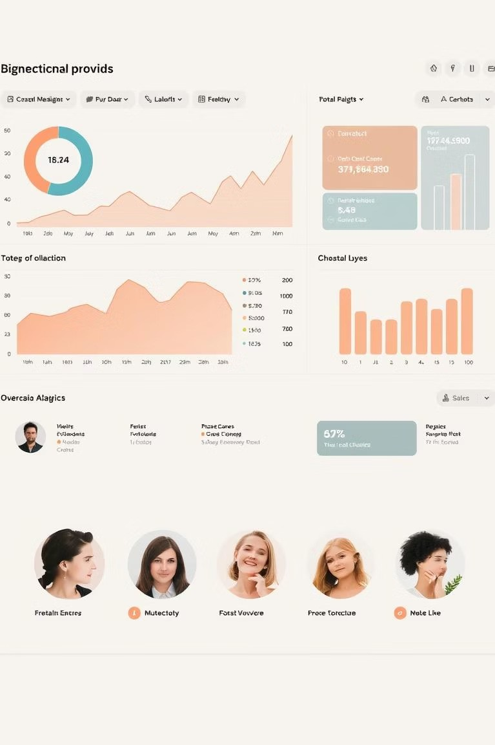




Sentiment Analysis of Social Media: Enhancing Insights with Image Understanding
The need to understand public opinion is growing in real-time.
Social media is a rich source for sentiment data. Image understanding improves analysis accuracy.
Raghav
Anjali Kumari 12203605

Slide 2
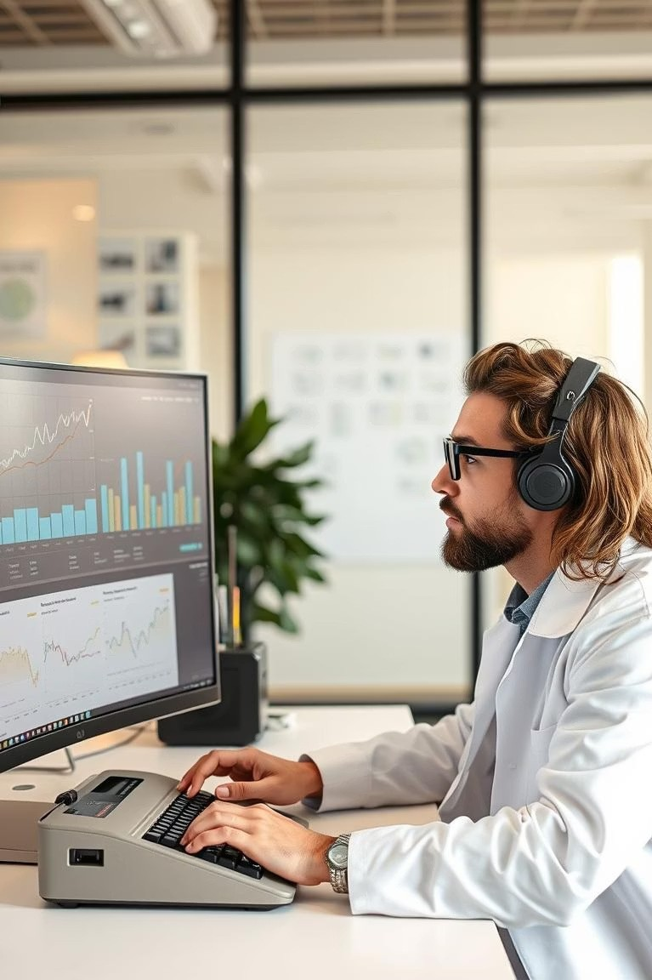


Understanding Sentiment Analysis
Sentiment analysis identifies and categorizes opinions in text.
Basic levels include positive, negative, and neutral.
Traditional methods use lexicon-based and machine learning approaches.
Positive
Expressing approval or satisfaction.
Negative
Expressing disapproval or dissatisfaction.
Neutral
Expressing no opinion or objective information.

Slide 3







Sentiment Analysis on Social Media
Analyzing social media data presents unique challenges.
Data sources include Twitter, Facebook, Instagram, and TikTok. Use cases include brand monitoring and market research.
Twitter
Real-time public opinions and trends.
Facebook
Community and group sentiments.
Instagram
Visually-driven opinions and lifestyle trends.

Slide 4




The Power of Image Understanding
Images convey emotions and opinions.
Image recognition identifies objects and scenes. Facial expression analysis detects emotions.
Image Recognition
Identifies objects, people, and scenes within images.
Object Detection
Locates specific objects within an image.
Facial Expression Analysis
Detects emotions from faces in images.

Slide 5




Integrating Image Understanding
Integrate image analysis into sentiment analysis.
Analyze both text and images to improve accuracy. Address sarcasm and irony using visual cues.
Restaurant Review
A tweet praising a restaurant with delicious food photo.
Product Review
A negative review of a product with a picture of damage.
Sarcasm Detection
Visual cues to identify sarcastic text.

Slide 6
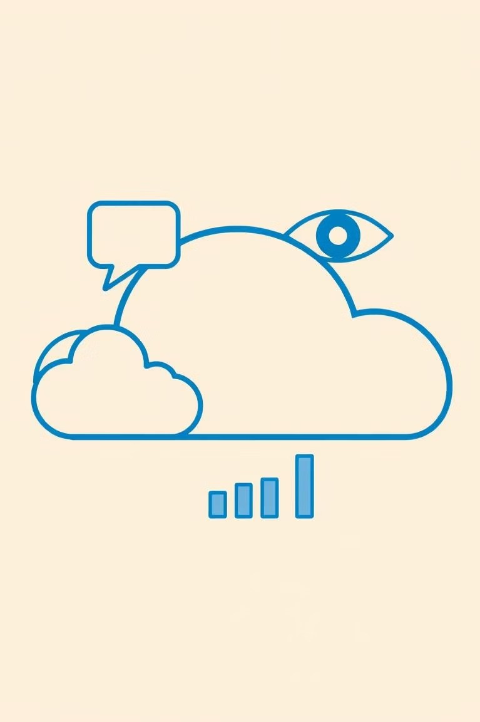


Tools and Technologies
Various tools and technologies are available.
CloudVision API offers sentiment analysis.
Open source libraries like OpenCV are available.
CloudVision API
Amazon Rekognition
Microsoft Azure

Slide 7




Case Studies and Examples
Brand sentiment analysis using Instagram posts.
Track political opinions using Twitter images.
Monitor public reactions using combined text and image analysis.
Brand Sentiment
Political Opinions
Public Reactions

Slide 8





Conclusion: The Future of Sentiment Analysis
Multimodal analysis is becoming increasingly important.
Advancements in AI and deep learning continue to improve accuracy. Ethical considerations are critical for responsible use.
2
AI Advancements
1
Multimodal Analysis
Ethical Use
3

